Slide 1
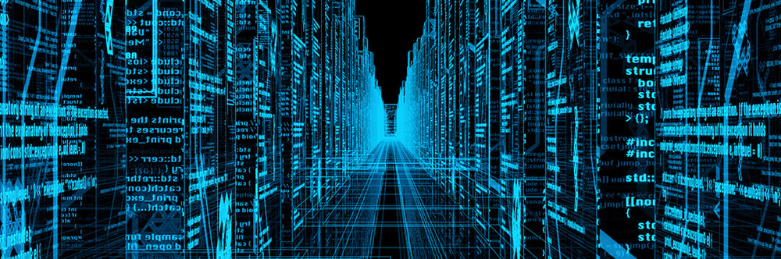
Database Security – An Overview
COM
Database Systems and Data Analytics (Week 7 Additional Materials)
736
Notes:
During the past few weeks, you have learned how to design and implement a database, add, delete and update data, fulfil various data retrieval requests using SELECT statements with appropriate conditions, functions, and subqueries etc.
As you may already know, data is the most valuable resource in the organisation.
This week we will be discussing various security issues that may compromise the safety and availability of the data as well as the countermeasures that are available to protect that data against security threats.
To begin with, we will have an overview of the various security issues in multiuser database applications.

Slide 2
Database Security
“The protection of the database against unauthorised access, either intentional or accidental”
Security countermeasures should combat threats and the consequences of such threats
Notes:
Database security can be defined as “The protection of the database against unauthorised access, whether it is intentional or accidental”.
Data security also focuses on ensuring data availability and data integrity.
Any malicious activity tampering data must be prevented.
Security countermeasures should combat the threats and should minimise the consequences of such threats.
Security is the responsibility of the entire organization.
Everyone within the organization must be educated and be aware of ensuring security. Every part of the system must be secured.
The following slide will list some of the potential threats that may occur in any computerised system highlighting the importance of implementing organizational-wide security countermeasures.

Slide 3
Security Threats
Hardware
Fire/flood/bombs
Power loss/surge
Theft of equipment
Software
Program alteration
Administrators
Inadequate security
Networks
Wire tapping
Cable breaking
Database
Theft of Data
Data corruption
Users
Using another user’s access
Unauthorized access
Hacking
Blackmail
Viruses
Operators
Trapdoors
Alterations
Inadequate training
Inadequate security
Theft of programs
SQL Injection
Excessive Privilege
Malicious software
Unauthorised access
Connolly & Beg
Notes:
A security threat is a possible danger that might exploit a vulnerability in the system.
An organization may face various threats, some of them are rare, but some may be very common and frequent. Some threats, even though very rare, may have large consequences.
This slide highlights some of the potential threats, categorized into various components of a system such as hardware, software, administrator, Network, Database, User, Operators etc.
Pause the video and examine the list. You can see each part of the system is vulnerable and why system security is considered the organisation's responsibility.

Slide 4
Compromising Security
Theft and fraud
Loss of confidentiality
Loss of privacy
Loss of integrity
Loss of availability
Notes:
As previously stated data is the most valuable resource within an organisation, data must be secured from every unauthorised access, either intentional or accidental.
In any security breach on the database, the organisation may face some or all of the following:
Theft and fraud
Loss of confidentiality
Loss of privacy
Loss of integrity
Loss of availability
These categorizations help the organization to plan and implement security countermeasures to prevent each of them happening.

Slide 5
Countermeasure
Authorization
Integrity
Views
Backup and Recovery
Encryption
RAID
Notes:
As various threats are affecting the data in different ways there are also several countermeasures.
Most of these are required to ensure the security, integrity and availability efficiently and effectively.
Authorisation: Allow or deny the access to the system, determines the authenticity of the user, verifies whether the user is whom they claim to be.
Integrity ensures the correctness of the data. Integrity constraints defined with the table definition ensures the data is valid, preventing misleading or incorrect data.
Views are Virtual table, that doesn't exist but produced upon request. Views can be created by including the necessary columns and leaving the confidential columns and other unnecessary columns in the base tables.
Backup and Recovery routine details the process of periodically copying the data that can be restored to protect organizations against data loss.
Encryption conceals the appearance of the original data known using special algorithms into unreadable by any program without an appropriate decryption key.
RAID, the redundant array of independent disks, is to ensure the hardware on which the DBMS running is fault-tolerant.
This ensures a smooth running of DBMS, preventing data loss and guaranteeing data availability.
In general, most of the above countermeasures are applied to ensure security in a multi-user environment.
However, these can be implemented to protect the data in a database in a database-specific way.
The following slides will give some examples of how these are applied in a database environment.

Slide 6
Authorization
Access controls
Granting a right or privilege to access a specific system or system object
User or role based access
Select, update, insert, delete data
Notes:
In Database, authorisation is managed by the DBA using access control mechanisms.
The DBA can grant the right or privilege to access a specific system or system object.
For example, a valid user and password can be used to authenticate the user.
Privilege to start a session will ensure the user can log-in and establish a connection to the database.
DBA can decide to manage these as user or role-based access rights.
There could also object-level privileges assigned to the user or user roles, for example, Select, update, insert, delete from tables.

Slide 7
Integrity
Constraints imposed at an object level to control the data being inserted
Entity integrity
No attribute of a primary key can be null
Referential integrity
A candidate row exists within a related table
Domain integrity
Allowable values for a given attribute
Semantic integrity
Ensuring data adheres to business rules
Notes:
Data integrity to ensure the correctness of data can be implemented using various integrity constraints that are available in the DBMS.
Constraints imposed at an object level. For example, at the table level, constraints are to control and verify the data being inserted.
Entity integrity ensures that no attribute of a primary key column can be null.
Referential integrity ensures a candidate row exists within a related table, in other words, there is no foreign key value without a relevant primary key value.
Domain integrity defines the data type of the attributes, allowing only certain values in a given attribute.
An attribute defined as a Date data type, you cannot enter 31-NOV-2020.
This will be treated as an invalid date and will throw an error message since November has only 30 days.
Semantic integrity ensures that the data adheres to business rules.
Appropriate data type along with validation rules for the attribute ensures semantic integrity.

Slide 8
Views
A means of restricting user access to certain data
Can restrict to specific attributes within a table
More restrictive way of maintaining access control at a sub-table level
Notes:
Views are very useful for providing a controlled view to individual users depending on what they are eligible to see, without overloading the database storage.
Views can provide restricted access to specific attributes within a table and can also hide table names and attribute names.
Views can be treated as tables. Accessing views can be controlled by assigning appropriate privileges to individual users.
Most of the time views contain less information than the base tables. This way, views provide a more restrictive way of maintaining access control, providing access control at a sub-table level.

Slide 9
Encryption
Encoding of data by algorithm, data will be unreadable without decoding
Symmetric key encryption
e.g. DES (Data Encryption Standard)
Asymmetric key encryption
e.g. RSA
Sometimes can be used in together
Notes:
Encryption is one of the most commonly used data protection mechanism.
Encryption encodes the data by algorithm, making the data is unreadable without the means to decode
In most cases the database holds private information, in some cases, it will be holding private, sensitive and confidential information as well. Security must be paramount if the system is storing data.
Encryption can be applied using
Symmetric key encryption e.g. DES (Data Encryption Standard)
Or Asymmetric key encryption e.g. RSA
Sometimes can be used in together in practice.

Slide 10
Backup and Recovery
Addresses threats such as hardware errors
Logging tracks the changes to the database
Most of the data is generated through transactions
Support smooth data recovery after a hardware/storage failure
Making sure that there are reliable Backup routines in place is very important for the data recovery
Notes:
Previous slides discussed various database-specific security countermeasures.
Even if there are no malicious attacks through software, data can still be lost by hardware failures, theft or by natural disasters.
Appropriate backup and recovery strategies must be implemented to counteract the data loss as a result of any hardware failure.
Database log files track the changes to the database, backup of log files are very important so that the recovery can be traced.
The success of a database recovery, after any failure, is dependent on the effectiveness of the backup strategy.
Making sure that there are reliable Backup routines in place is very important for the data recovery as most of the data is generated through transactions. Appropriate Backup Recovering strategies support the smooth recovery of data after any hardware/storage failure.

Slide 11
RAID
Redundant Array of Independent Disks
Copies data across a bank of disks
Different RAID levels can be used addressing redundancy (mirroring), striping and parity
Creates a more fault tolerant system than using a single disk
Addresses similar issues to backup and recovery
Notes:
The very last countermeasure again related to the physical storage of the data is the application of RAID.
As mentioned at the beginning, RAID, the redundant array of independent disks, is to ensure the hardware on which the DBMS running is fault-tolerant. The system copies data across a bank of disks, different RAID levels can be used addressing redundancy (mirroring), striping and parity.
Addresses similar issues to backup and recovery as the reliability and the availability of the data is improved by storing redundant data across multiple disks.

Slide 12
Next
Database security measures
DBMS provides various security measures to protect the database systems and the data
Notes:
This session has provided an overview of security threats and the countermeasures available to protect or reduce the impact of any accidental or intentional attack and its implementation in a database environment.
The next session will discuss the DBMS’s role in ensuring database security.

